Slide 1
Sporting Event Predictor
David Lin and Ben Wagle
December 2013

Slide 2
Introduction
Sport event statistics are routinely, and often thoroughly, kept and made publicly available
People love predicting the outcome of sports and often claim to have some sort of intuition, secret formula, or “a good feeling”
Fantasy sports, playoff brackets, racetrack gambling, March Madness
How accurately can ML algorithms predict sports using only statistical data?

Slide 3
Goals and Predictions
Use statistics from ESPN to predict NBA games
NBA holds 1230 basketball games per season, more games than other sports’ seasons
Stats are relatable to many other sports
Realistically we don’t expect a perfect, or close to perfect, classifier
Some factors of sports are not predictable or quantifiable
60–70 percent correct would be reasonable

Slide 4
Approach
Initially work with Perceptron and PEGASOS, which we are familiar with
Want to begin with linear classifiers as a base
Don’t expect data to be linearly separable
Kernel methods and decision tree should be able to classify games more accurately with nonlinear boundaries

Slide 5
Data
Game as a data point
Home team’s win/loss result is a game’s label
Features are the home and away teams’ average statistics for the season up to, but not including, the current game
Classifier should be able to compute which features (statistics) are most pertinent to a game’s result

Slide 6
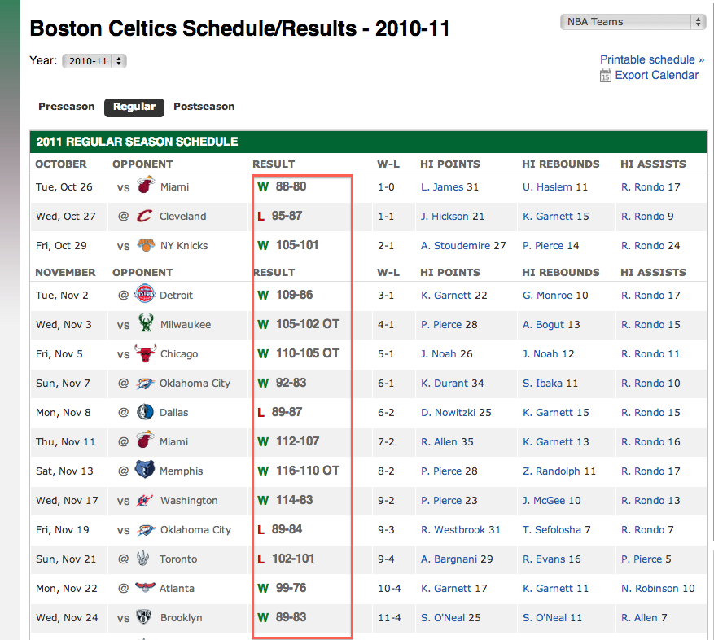
Data: Acquisition

Slide 7
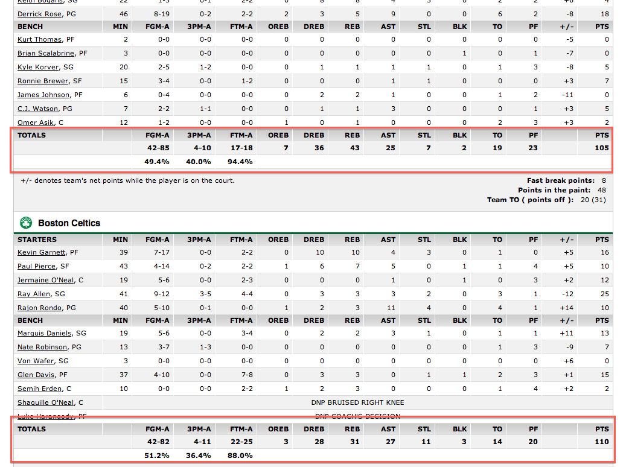

Slide 8
Data: Preparation
For every season, sort each team’s games chronologically
Compute average stats for the team up to the current game
Concatenate two teams’ average stats to form a feature vector for a game
Normalize between 0 and 1
Invert away team’s features to negative values

Slide 9
Linear Classifiers
Initially train on two seasons, validate on one, test on one
Ultimately, for all classifiers, we trained on 8 seasons, validated on one, and tested on one.
Then varied size of training set to show that the small number of features (32) leads to an increase in training error as the size of the training set increases
Also varied number of iterations through the data

Slide 10
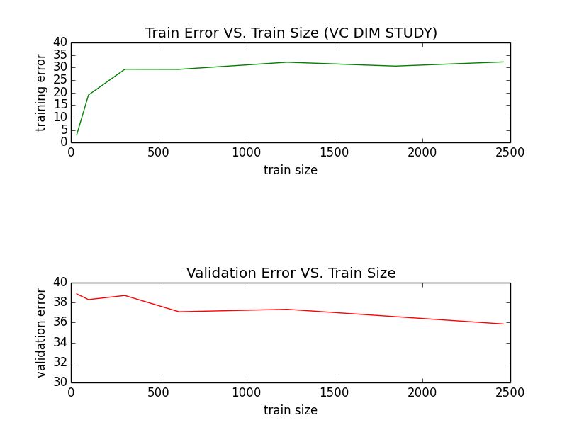
Perceptron

Slide 11
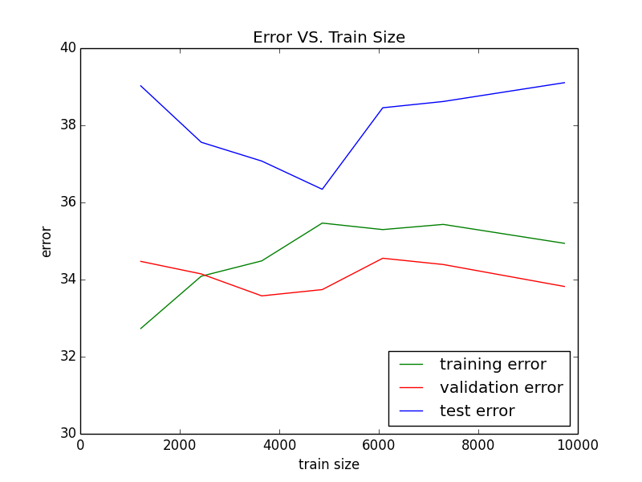

Slide 12
Perceptron
Best Validation Error: 33% (Test Error= 36.3%)
Worst Validation Error: 34.5% (Test Error= 38.4%)
We saw that as the training sized increased, the training error increased as well.
This can be attributed to the low VC Dimension of our 32-D feature vectors.

Slide 13
PEGASOS

Slide 14
PEGASOS
From total training set error, best training set size is 2423, though the error stabilizes to about 35% after a training set size of 1000
Test result: 65.85% successful

Slide 15
Nonlinear Classifiers
When visualized, it’s clear a hyper plane would have difficulty separating the game data

Slide 16
Gaussian Kernel

Slide 17
Gaussian Kernel
By varying the cost, we minimized the validation error and used that model on the test data
Test Result: 65.94% successfull

Slide 18

Decision Trees
Used two methods for calculating best feature to split on at each node:
Gini Impurity: computed by summing the probability of each item being chosen times the probability of incorrectly classifying the item.
Entropy: (we know from class)
Both methods yield very similar results.

Slide 20

OPEN THE COOLER TREES

Slide 21
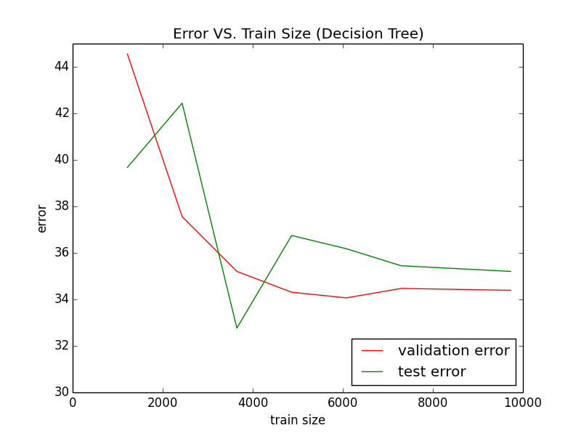

Slide 22
Decision Trees
Best Validation Error: 34.1% (Test Error= 36.2%)
Worst Validation Error: 44.6% (Test Error= 40.7%)
We found a good test performance (32.8%) with 3648 data points.
From cross validation, we found the optimal depth was 4.

Slide 23
Analysis of Results
Test set classification score recap:
Perceptron: 63.7%
PEGASOS: 65.85%
Gaussian kernel: 65.94%
Decision trees: 67.23%
Reached initial goals of 60–70 percent, but expected nonlinear methods to perform a little better than they did

Slide 24
Analysis of Results
With only 32 features, the low VC dimension resulted in an increasing training error, as well as the training error nearing validation error.
By limiting the height of the decision trees, we were able to make our classifier generalize better. As the tree deepened, we began to see an increasing gap between our validation and test errors due to over fitting.
We originally included win-streak in our feature vectors, but were getting less than 1% validation and test error.
Sometimes even 100% correct.
Perfect prediction in sports obviously not possible.
The weight on home win-streak was 5X larger than any other weight.
Never predict the end of a win streak that way.

Slide 25
Tree when including the corrupted win-streak feature

Slide 26
What’s Next
Add more features
Different statistics kept by different sources
Individual player statistics
Team specific weight vectors
Try algorithms on other sports
Cross-sport classification
Use our current classifiers directly on another sport’s games
Ex: For soccer, two soccer teams’ steals averages weighted by the steals weight from our NBA trained classifier, other direct mappings of statistics between sports

